Slide 1
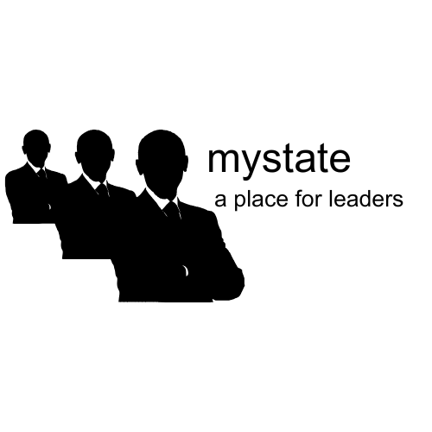
MyState
A Platform By Lockheed Marvin

Slide 2
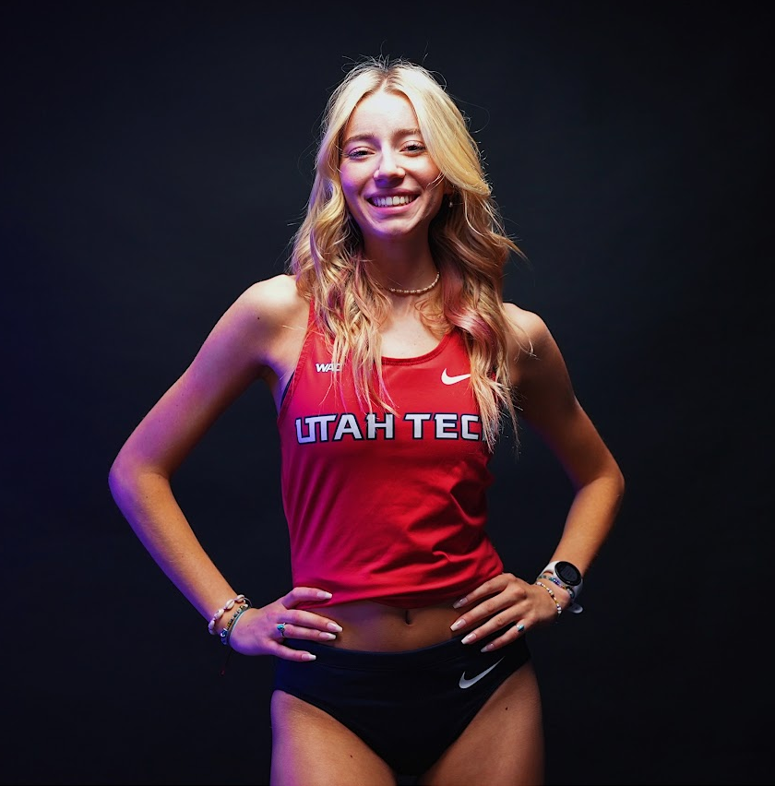
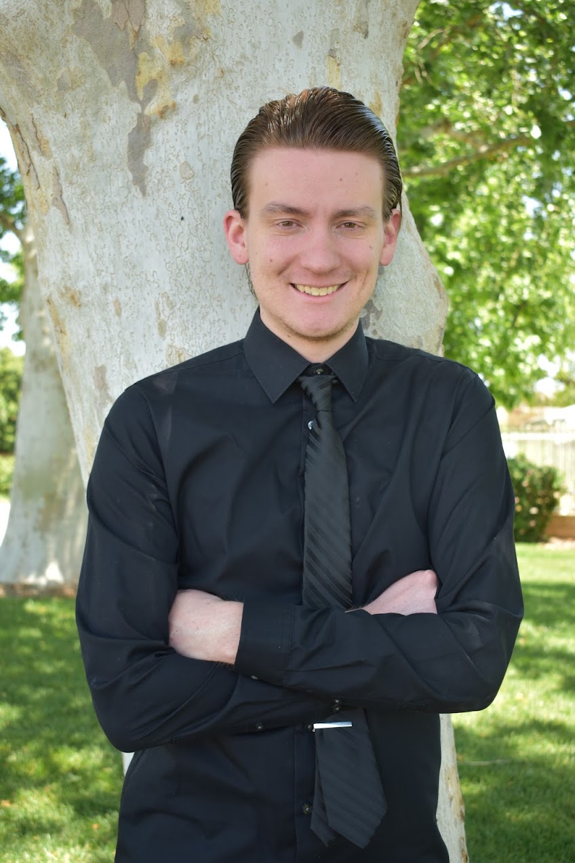
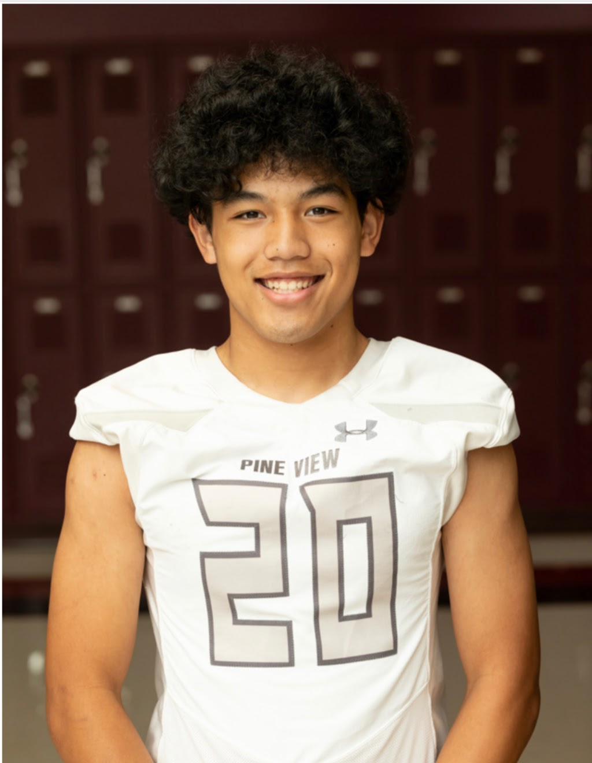
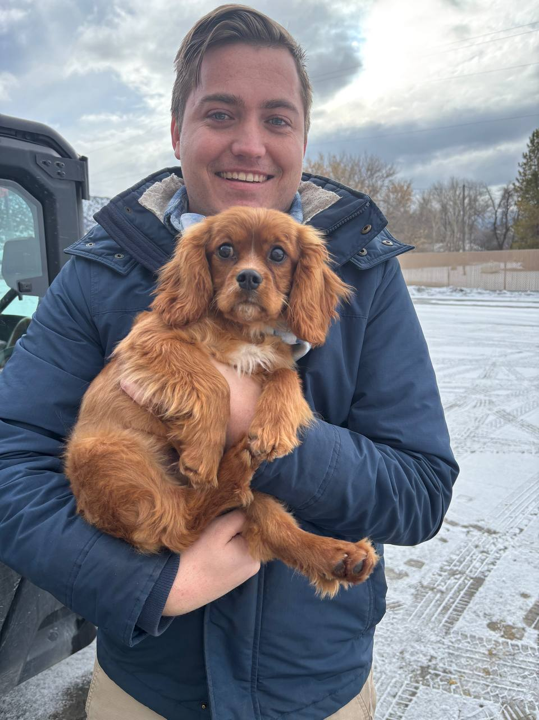
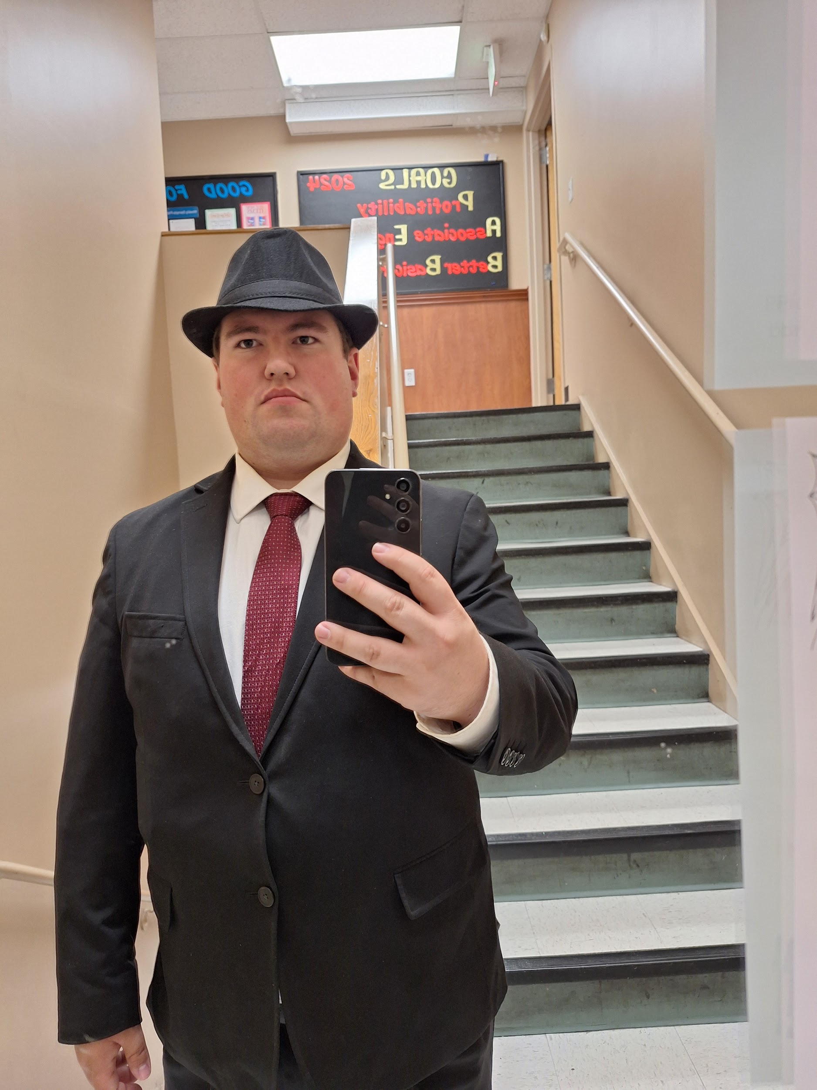
Developer Introductions
MyState Pitch
Team Introductions
Averie
CE Major
Is on the UT XC/Track Team
Garrett
SE Major
Have a degree in Web Development
and Web Publishing & Design
Doug
SE Major
Loves food
Tanner
CE Major
Is a new dog dad
Rylynn
SE Major
(Allegedly) Was in the Italian Mob from 2007-2022

Slide 3

MyState Purpose
Purpose of MyState
MyState Pitch
The purpose of MyState is to create a social media platform exclusively for world leaders to interact. It is through this more personal interaction that we will decrease conflicts and promote world peace.
Rylynn Peters

Slide 4
MyState: Leadership Interactions of the Future
World Leader Interaction
-Posts by leaders, for leaders
-Showcase of the nation
-Comments from the populace
-Leader to leader messaging
Rylynn Peters

Slide 5
Version 1.0 Specs
-Users will be able to create their own profiles with a bio. These will have profile pictures, names, and a short biography
-Users can reply to other world leader’s posts. Users can also send private messages to each other. Some world leaders may restrict users from replying to other world leaders
-World Leaders can make posts with images and videos. They can also make polls for their users to vote
-Everyone can vote for the head admin of the page. The head admin will be able to set the rules for the website and be able to post their favorites (censoring content, making sure their posts are at the top, etc.)
-The head admin of the page will be able to post favorites including: foods, quotes, movies, TV shows
Garrett Kilgore

Slide 6
Future Versions : Out of Scope For 1.0
-Ability for leaders to allow/disallow spectating from other specific countries
-Allow citizens to view all current laws, and view laws currently in the proposal, voting or delegation process
-Ability to store critical documentation of each user in order to identify them on a professional/legal level
-Ability for citizens to vote (where applicable)
-Ability host public/private court sessions of any type up to the national level
-Ability to host international meetings/summits
Tanner Jeffris

Slide 7
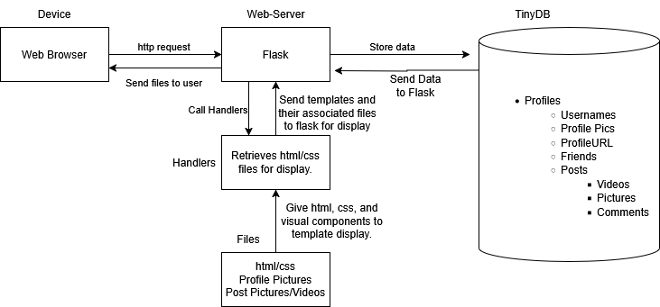
Project Architecture
Project Architecture
MyState Pitch
3rd party tools
Flask:
Works with HTML documents
Listens for button presses, etc.
TinyDB
NoSql Simple database written in Python
Lightweight and embedded
HTML
Form aesthetics of the website
Build user interface
Heavy Lifting is done through Flask
Averie Perriton

Slide 8
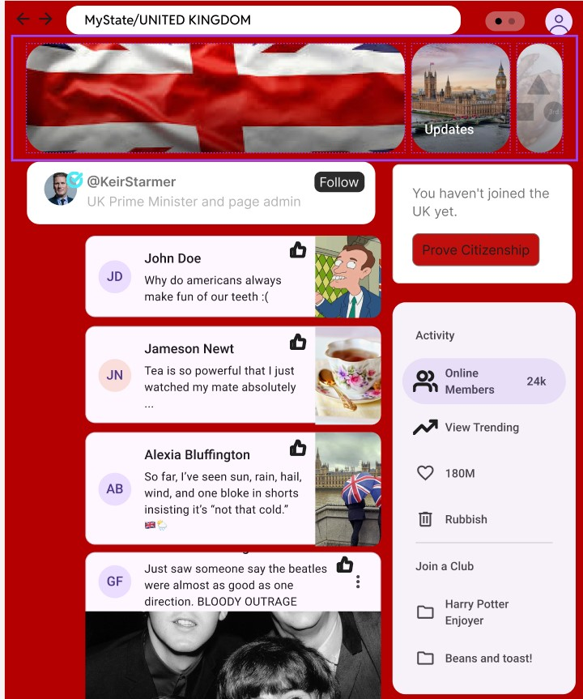
UI Mockup
Averie Perriton

Slide 9
Summary and Conclusion
MyState is a dynamic social media platform designed to bridge the gap between national leaders and their followers. With MyState, national leaders can directly engage with the people they serve, ensuring transparency and fostering trust within the community.
In addition to enhancing the relationship between leaders and citizens, MyState empowers citizens to communicate and engage with their fellow followers. Through easy-to-use tools for sharing ideas, discussing issues, and participating in conversations, citizens can play an active role in shaping the future of their nation. Whether it’s through commenting, sharing updates, or starting discussions, MyState fosters a community of informed and engaged individuals who can contribute meaningfully to the national conversation.
Together, MyState creates an open, collaborative space where both leaders and citizens stay connected, informed, and empowered to create positive change.
Douglas Leung Choi

Slide 10
Q&A
Any questions?

